Slide 1
Chapter 6

Slide 2
Objectives

Slide 3
Objectives (cont.)

Slide 4
The basic syntax for coding a method

Slide 5
A method with one parameter that returns a decimal value

Slide 6
A method with three parameters that returns a decimal value

Slide 7
The syntax for calling a method

Slide 8
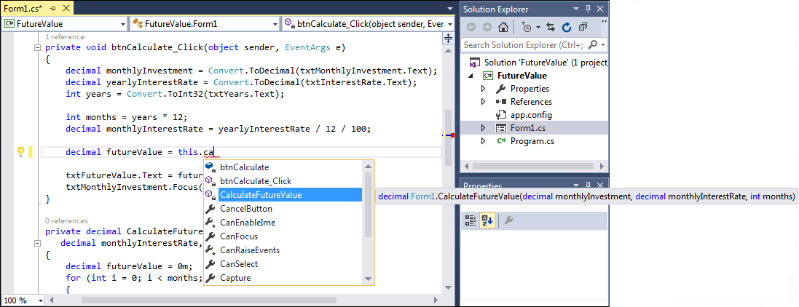
The IntelliSense feature for calling a method

Slide 9
The syntax for an optional parameter

Slide 10
A statement that passes arguments for all three parameters to the function

Slide 11
Two statements that pass the arguments for two parameters by name

Slide 12
The btnCalculate_Click method with selected statements

Slide 13
The method call that replaces the selected code

Slide 14
How to use refactoring to create a new method from existing code

Slide 15
The basic syntax of the parameters in a parameter list

Slide 16
Code that works with the CalculateFutureValue method

Slide 17
Code that works with a CalculateFutureValue method that uses the out keyword

Slide 18
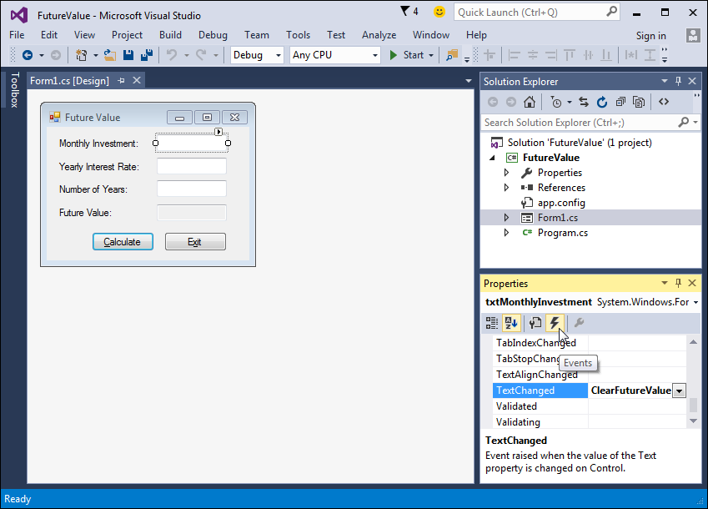
The Events list for a text box control

Slide 19
The default event handler for a text box

Slide 20
A custom event handler for a text box

Slide 21
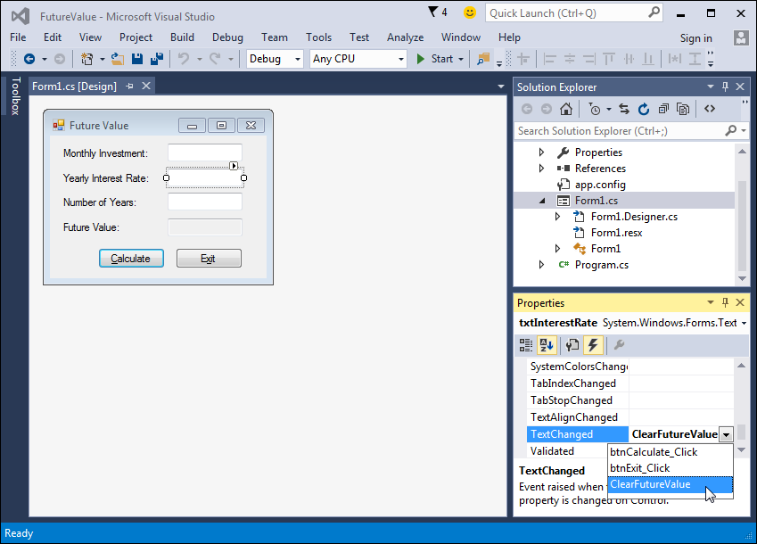
How to select an existing event handler for an event

Slide 22
How to wire an event to an existing event handler

Slide 23
The code for the methods in the Future Value application

Slide 24
The code for the methods in the Future Value application (cont.)

Slide 25
Some of the generated code in the Designer.cs file for the form

Slide 26
Some of the generated code in the Designer.cs file for the form (cont.)

Slide 27
Extra 6-1 Create a simple calculator

Slide 28
Extra 6-2 Add a method and an event handler to the income tax calculator

